Slide 1
FINAL PROJECt
Simple library management system using java applet
Submitted by
D. SIVAKARTHIKEYAN

Slide 2
INTRODUCTION
This project aims to develop a basic Library Management System (LMS) using Java Applet technology. An LMS is a software application designed to manage and organize the daily operations of a library. This system will provide a user-friendly.
Why Java Applet?
Java Applets, though less prevalent in modern web development, offer certain advantages for this project:
Platform Independence: Java Applets can run on any platform with a Java Virtual Machine (JVM), ensuring wider accessibility.
Graphical User Interface (GUI): Java's rich GUI components provide a suitable foundation for creating an intuitive library interface.
Security: Applets can operate within a sandbox environment, providing a degree of security for sensitive library data.

Slide 3
working
A basic Library Management System (LMS) using Java Applet primarily consists of:
Java Applet: The graphical user interface (GUI) component that interacts with the user.
Book Class: Represents a book with attributes like title, author, Issued,price, etc.
Member Class: Represents a library member with attributes like name, ID, details, etc.
Applet Initialization:
Loads the necessary classes and components.
Use the button,textfield,label ETC.

Slide 4
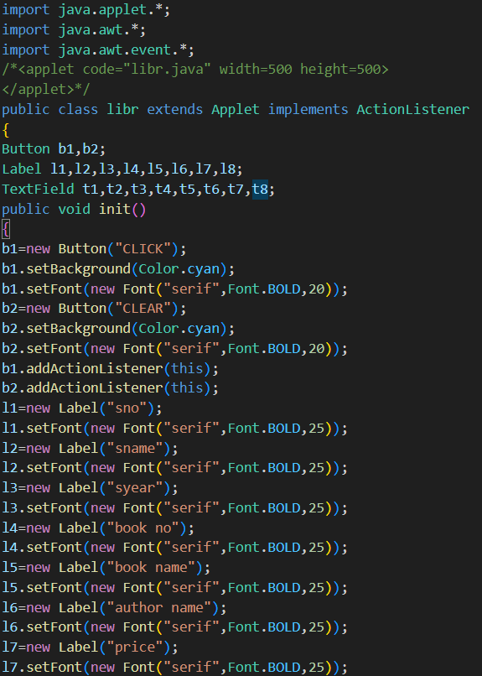
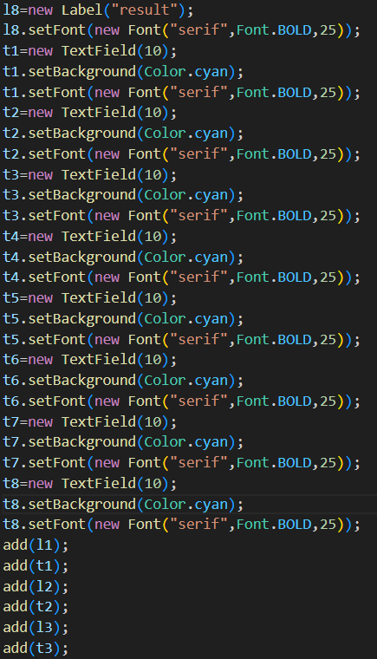
code

Slide 5
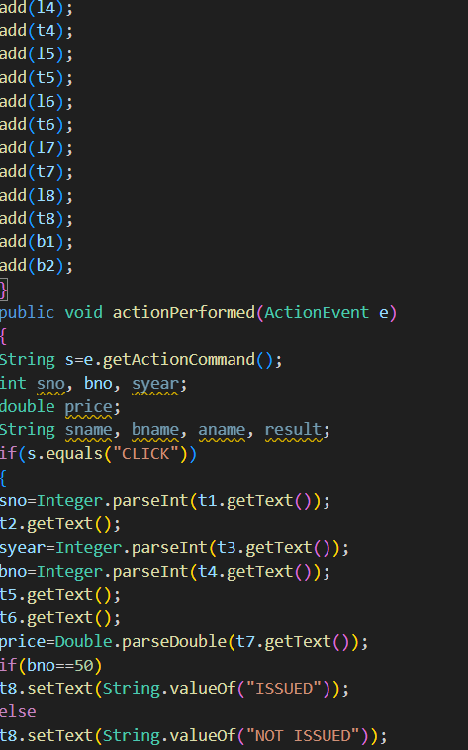
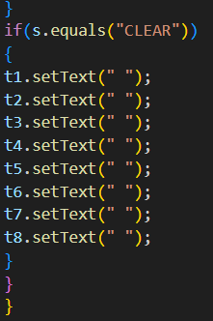

Slide 6

Compilation: Compiling a Java applet is essentially the same as compiling any other Java class.

Slide 7
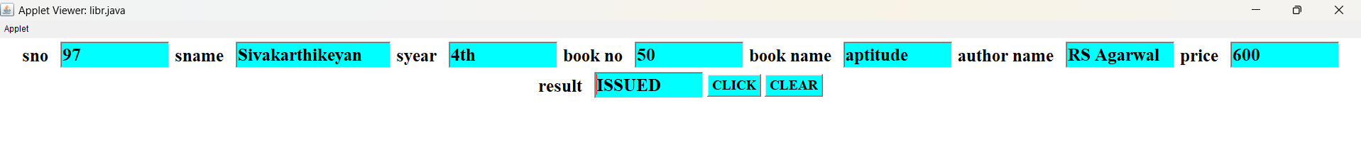
Output if(book == 50) book issued, else the book not issued

Slide 8
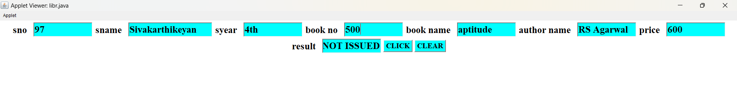
Book number is not equal to 50, so the book is not issued

Slide 9
Uses
While Java Applets are no longer widely used for web applications due to security concerns and browser compatibility issues, a simple Library Management System (LMS) built with Java Applet can still be beneficial in certain contexts:
Educational Purposes
Learning Java: Developing a LMS is an excellent hands-on project for students learning Java programming. It helps them understand core concepts like object-oriented programming, GUI development, and data structures.
Teaching Library Management: It can be used as a teaching tool to demonstrate library operations and processes to library science students or library staff.

Slide 10
advantages
disadvantages
Educational Benefits
Hands-on Learning: Building a LMS with Java Applets provides a practical learning experience for students and developers.
Understanding Core Concepts: It reinforces fundamental programming concepts like object-oriented programming, GUI development, and data structures.
Offline Functionality
Standalone Operation: In environments with limited or no internet access, a Java Applet-based LMS can operate independently.
Security Concerns
Limited Security: Applets operate within a sandbox environment, restricting their access to system resources. This can make them vulnerable to security threats.
Platform Dependence
JVM Requirement: Users need a Java Virtual Machine (JVM) installed to run the applet, which can be a limitation.
Browser Compatibility: Older versions of Java and browsers might be required, reducing accessibility.

Slide 11
FUTURE SCOPE
Potential (Limited) Future Directions:
Educational Tool: It can continue to be used as a teaching aid to introduce students to programming concepts.
Small-Scale, Isolated Systems: For extremely small, isolated libraries with minimal requirements and no internet access, it might be a viable option, but even in these cases, modern alternatives should be considered.
Recommended Future Paths:
Considering the drawbacks of Java Applets, it's strongly recommended to explore these alternatives for a library management system:
Java-based Web Applications: Using technologies like Java Servlets, JSP, or frameworks like Spring MVC to create web-based LMS solutions offers better scalability, security, and user experience.
Mobile Applications: Developing mobile apps for librarians and patrons can enhance user experience and accessibility.

Slide 12

Thank you

